Slide 1
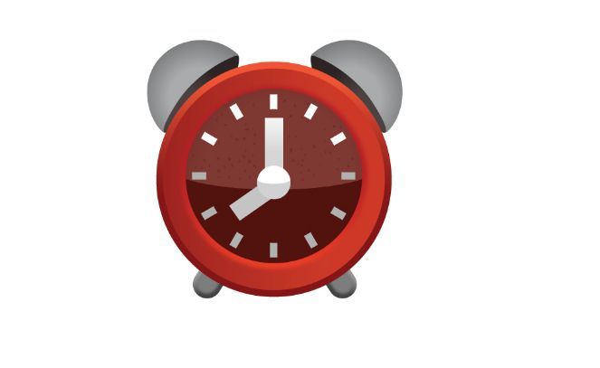
Python project on Alarm Clock⏰
Presented by Nandhini

Slide 2
About python
Python is an open source, general purpose programming language that is easy to read and powerful.
writing programs in python is less time consuming compared to any other languages.
It is an interpreted language, which do not need to be compiled to run.
Python is a high level language that will make a programmer focus on what to do instead of how to do.

Slide 3

Feature Of Python
High Level Language
Extensible Feature
Object Oriented Language
GUI programming support
Python is integrated language
Easy to code
Extensible feature

Slide 4
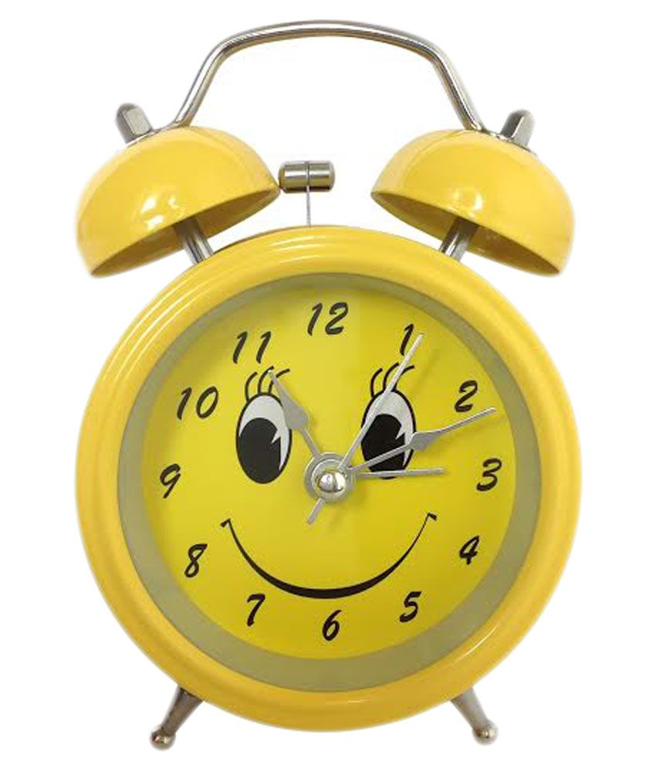
Aim Of The Project
The objective of our project is to implement an alarm clock using Python.
Python consists of some very innovative libraries such as datetime and Tkinder which help us to build the project using the current date and time as well as to provide a user interface to set the alarm according to the requirement in 24-hour format.
Python consists of some very innovative libraries such as datetime and tkinter which help us to build the project.

Slide 5
Purpose Of The Project
Purpose of this alaram clock project using python is a project build in a python programming language.
This python alaram clock project contains the essential libraries of datetime and Tkinder, which assist us in constructing projects utilizing the current date and time.
This project requires good knowledge of python and GUI(graphics user interface).
Python when combined with tkinder provides fast and easy way to create GUI application.

Slide 6

EXPLANATIONS FOR IMPORT LIBRARIES:
Tkinter module belongs to a standard library of GUI in Python. It helps us to create a dialog box with any information that we want to provide or get from the users.
And time modules in python help us to work with the dates and time of the current day when the user is operating python and to manipulate it too.
Winsound module provides access to the basic sound playing machinery provided by Windows platforms. This is useful to generate the sound immediately when a function is called.

Slide 7
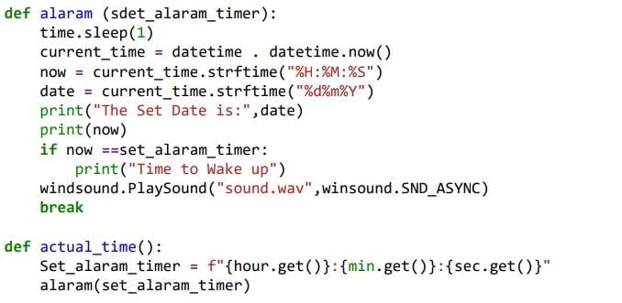
Create a WHILE LOOP
  worDefine a function named as alarm() which takes theargument of (set_alarm_timer).It contains a while loop with a Boolean function True which makesv the program automatic to work.
time.sleep(1) halts the execution of the further commands given until we get the time value from the user later in the code and returns the background thread of the clock time going on at a regular interval.
Get the current time using current_time which takes the argument e while loop which we further use while making GUI.
now is used to print the time and date is used to print the current date by string conversion using strftime().
Define another function here named actual_time() which takes in the user value for setting the alarm in the string format. The same argument of (set_alarm_timer) as alarm before to execute the while loop which we further use while making GUI
If loop suggests that if the user input time set_alarm_timer matches with the while loop ongoing time now, the message is printed as” Time to Wake up”.
winsound.SND_ASYNC plays the system generated sound as soon the condition satisfies, acting as a reminder for the alarm clock.

Slide 8
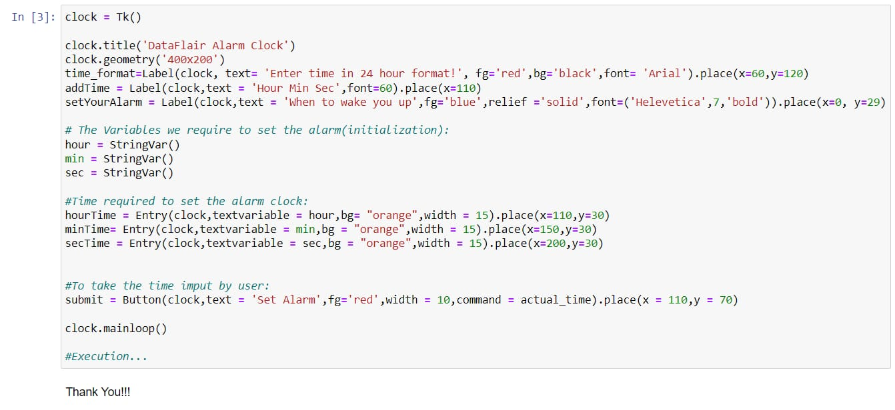
Creating GUI using tkinder

Slide 9
Explanation for GUI
To Initialize tkinter, we pass a command under the name clock as Tk().
The dialog box has the title as DataFlair Alarm Clock with a geometry of (400*200). We pass on the heading to mention the time format for 24 hours using time_format.
The second heading is given above the user input boxes for the labeling to be “Hour Min Sec” using addTime.
Just to make the dialog box look funkier, adding another label as “when to wake you up” using setYourAlarm.
As we have already converted the current time in the string before (actual time), the variables we initialize for the user input dialog boxes are in StringVar().
Finally make the input boxes such as hourTime, minTime, and secTime which takes the entry of the time the user wants to set the alarm on in 24-hour format.
Submit takes the command of the defined function actual_time and executes the clock as it acts as a set button to start the program.
Clock.mainloop() is the basic and the last command was given to compile all the previous commands with their basic settings of color, font, width, axis, etc. and displays the window as soon as the program is run.

Slide 10
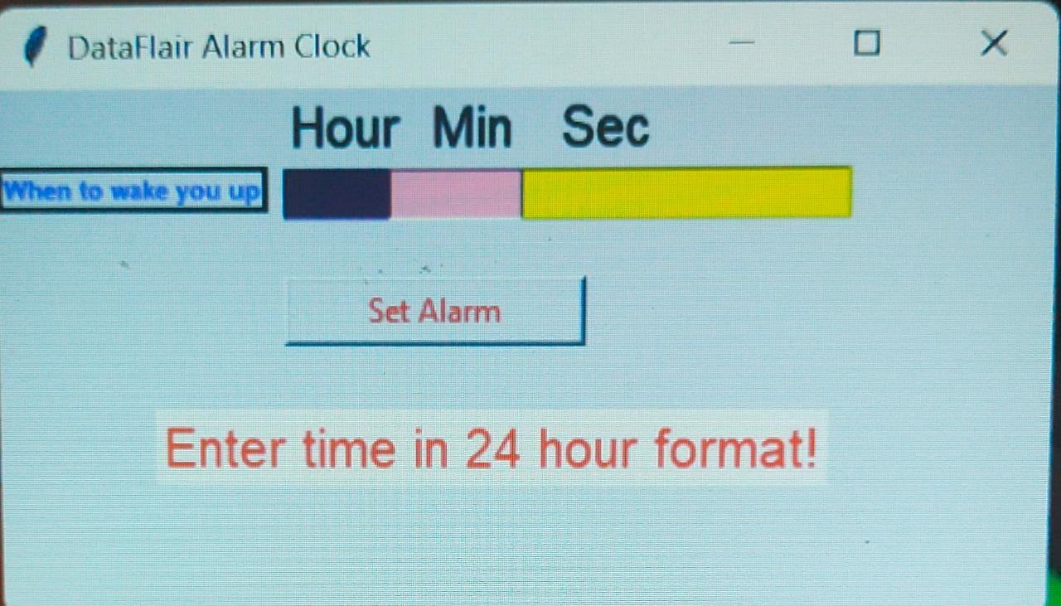
OUTPUT of Dataflair alaram clock
And finally, we get the out of the dataflair alaram clock out.
Now, We can set it for which time we have want to wakeup from sleep

Slide 11
